Slide 1
Candy Grab Game
Grab an Agent card and game pieces
Form groups of 2 (or 3 with an observer)
Play the game based on your Agent card!
13 pieces on the table
Take turns taking either 1 or 2 pieces
Person forced to take the last pieces loses ☹
Think about how you might implement your Agent in code

Slide 2

CS10: The Beauty and Joy of Computing
Artificial Intelligence
Pat Virtue
with slides from Anna Rafferty
with slides from Dan Garcia
and slides from Pieter Abbeel
with slides from Dan Klein
with slides from Stuart Russell
Notes:
http://www.youtube.com/watch?v=SqBw7XapJKk – bicycle robot
RL-NN Atari
https://www.youtube.com/watch?v=cjpEIotvwFY
https://www.youtube.com/watch?v=EfGD2qveGdQ

Slide 3
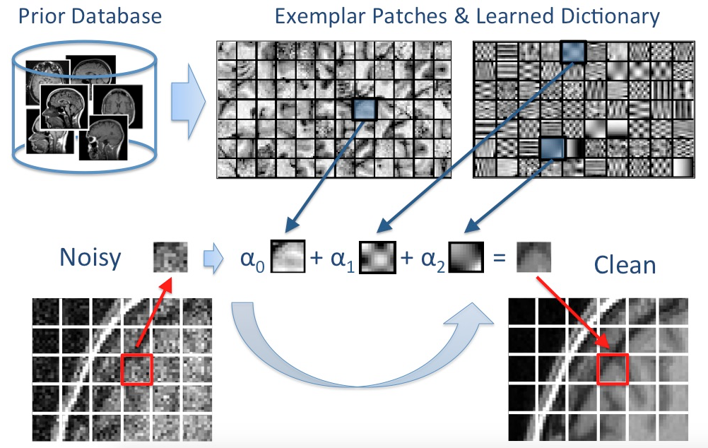
What I Do…

Slide 4
Outline
What is AI?
Some AI history: AI winter and the resurgence!
AI Techniques:
Logic
Search & Planning
Probability & Statistics (Machine Learning)
AI Applications
Natural Language
Vision / Perception
Robotics
Much, much more

Slide 5
Outline
What is AI?
Some AI history: AI winter and the resurgence!
AI Techniques:
Logic
Search & Planning
Probability & Statistics (Machine Learning)
AI Applications
Natural Language
Vision / Perception
Robotics
Much, much more

Slide 6
Candy Grab Game
function takeTurn(numPiecesAvailable)
return ?

Slide 7
Candy Grab Game
Agent 001 – Always choose 1
function takeTurn(numPiecesAvailable)
return
1

Slide 8
Candy Grab Game
Agent 002 – Always choose 2
function takeTurn(numPiecesAvailable)
return
2

Slide 9
Candy Grab Game
Agent 004 – Choose the opposite of opponent
function takeTurn(numPiecesAvailable)
return ?

Slide 10
Candy Grab Game
Agent 007 – Whatever you think is best
function takeTurn(numPiecesAvailable)
return ?

Slide 11
Candy Grab Game
Agent 007 – Whatever you think is best
function takeTurn(numPiecesAvailable)
if multipleOf3(numPiecesAvailable)
return 2
else
return 1

Slide 12

Candy Grab Game
Agent 007 – Whatever you think is best
function takeTurn(numPiecesAvailable)

Slide 13
Candy Grab Game
Agent 007 – Whatever you think is best
function takeTurn(numPiecesAvailable)
Keep track of win % statistics from past games
Pieces Available | Take 1 | Take 2
2 | 100% | 0%
3 | 2% | 100%
4 | 3% | 2%
5 | 90% | 5%
6 | 7% | 88%

Slide 14
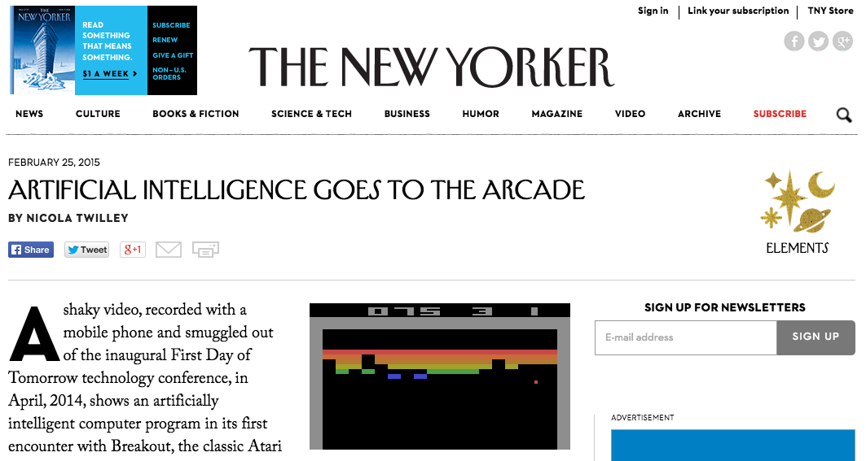
AI Games in the News
https://www.youtube.com/watch?v=EfGD2qveGdQ
Notes:
https://www.youtube.com/watch?v=EfGD2qveGdQ

Slide 15
So what is AI?

Slide 16
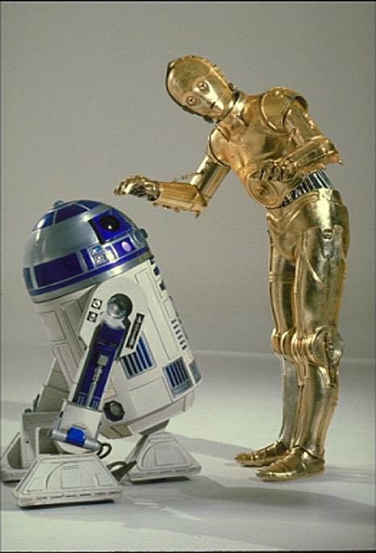
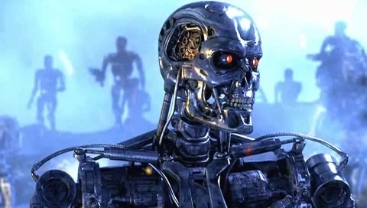

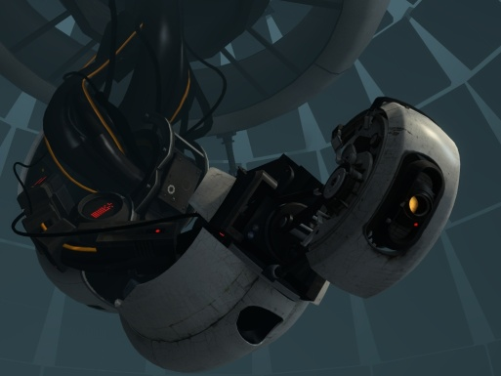
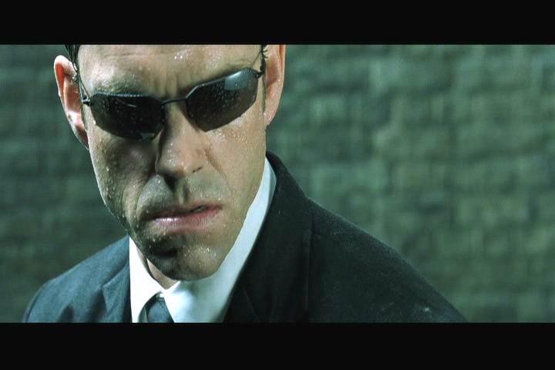
Sci-Fi AI?
Notes:
Who are these? C3PO, what does he do? Essentially google translate, (but with anxiety!)
Little guy? R2D2 – what does he do, yeah, not so sure
Things got darker: machines come back from the future – to kill us!
90’s : software is scary
Basic fear about what technology might do ?
What if we can’t even tell technology apart from ourselves?
OR maybe it’ll look really different and snarky
Who are these? C3PO, what does he do? Essentially google translate, (but with anxiety!)
Little guy? R2D2 – what does he do, yeah, not so sure
Things got darker: machines come back from the future – to kill us!
90’s : software is scary
Basic fear about what technology might do ?
What if we can’t even tell technology apart from ourselves?
OR maybe it’ll look really different and snarky

Slide 17
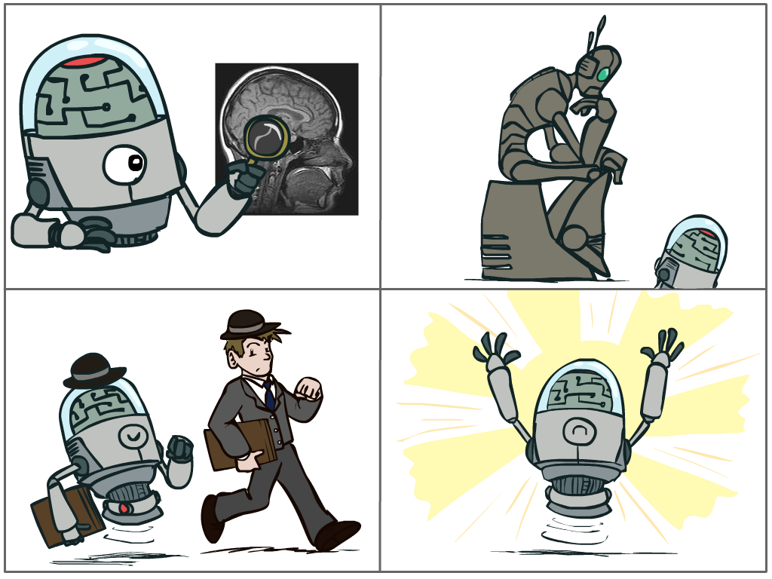
So what is AI?
The science of making machines that:
Think like people
Think rationally
Act like people
Act rationally

Slide 18

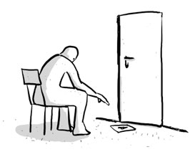
Turing Test for Intelligence
In 1950, Turing defined a test of whether a machine could “think”
“A human judge engages in a natural language conversation with one human and one machine, each of which tries to appear human. If judge can’t tell, machine passes the Turing test”
en.wikipedia.org/wiki/Turing_test

Slide 19
So what is AI?
The science of making machines that:
Think like people
Think rationally
Act like people
Act rationally

Slide 20
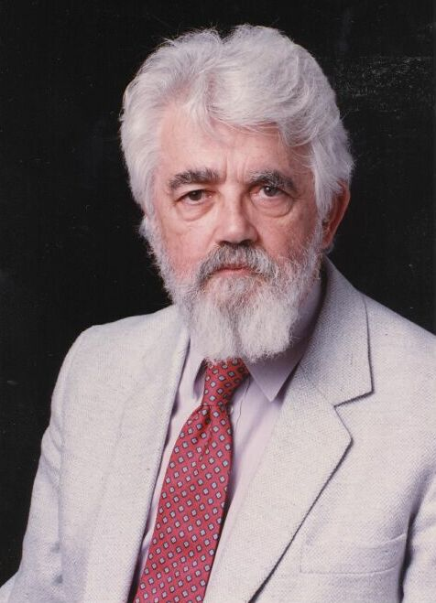
AI Definition by John McCarthy
“Getting a computer to do things which, when done by people, are said to involve intelligence”
Finesses the idea of whether a computer has consciousness, whether they have rights, etc.

Slide 21
Outline
What is AI?
Some AI history: AI winter and the resurgence!
AI Techniques:
Logic
Search & Planning
Probability & Statistics (Machine Learning)
AI Applications
Natural Language
Vision / Perception
Robotics
Much, much more

Slide 22
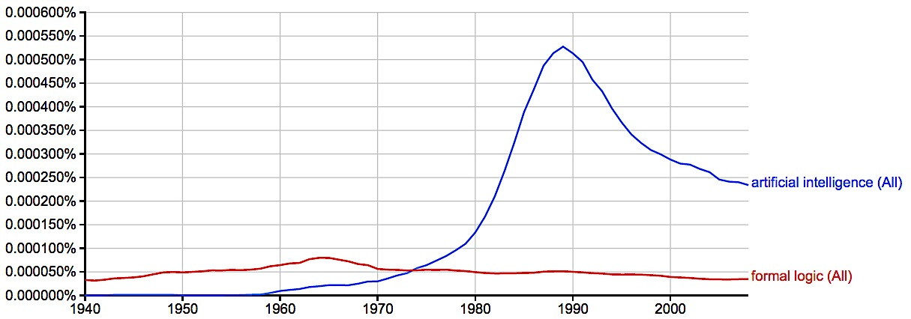
A Brief History of AI
Knowledge Based
Systems
1970-1990
AI
Excitement!
1950-1970
artificial intelligence
formal logic
Google ngrams

Slide 23
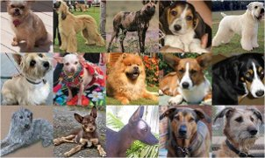
Clicker Question
Which of these rules is true for all dogs?
(A) Has four legs
(B) Has fur
(C) Barks
(D) None of the above
(Image from: http://vision.stanford.edu/resources_links.html)
Notes:
Peer instruction: Can you think of a rule that always works for identifying dogs? What problems does this pose for making an intelligent system?
- If everyone gets it right: talk to your partner about how you might surmount this issue with rules and symbols)

Slide 24
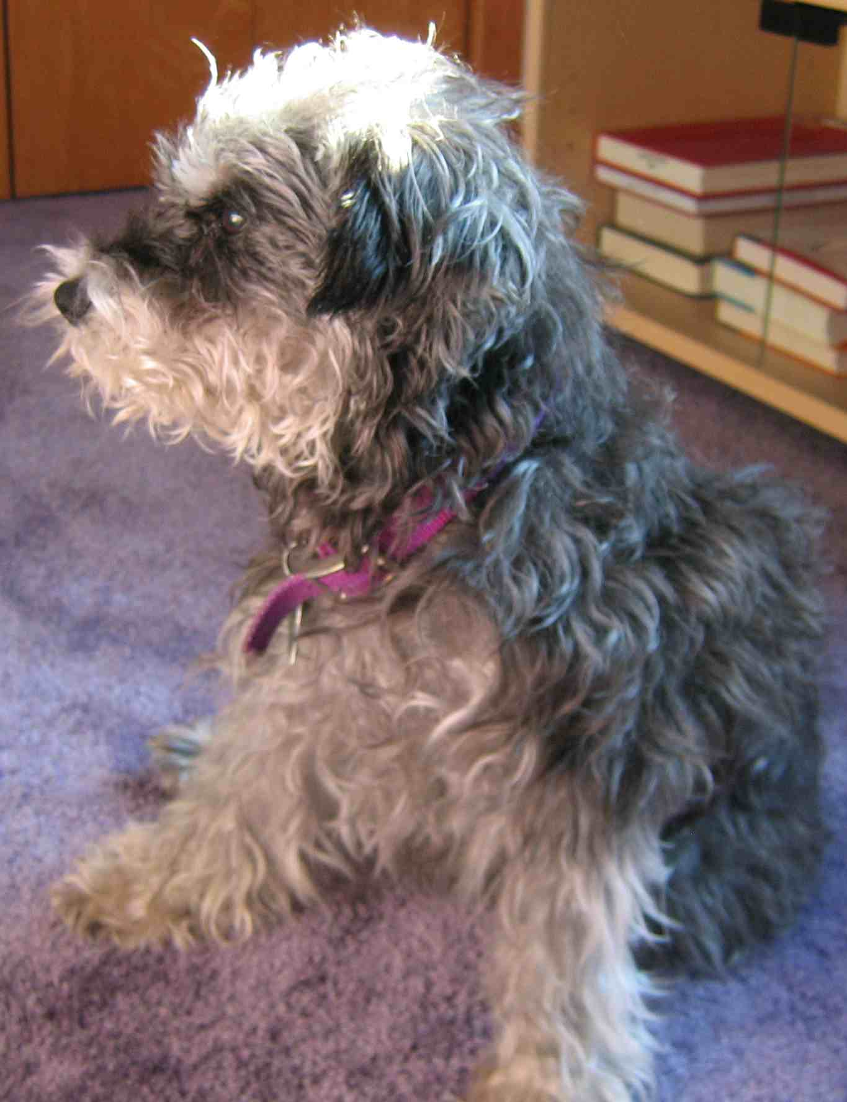
Revival of AI: Big Ideas
Brittle rules break down in the real world
Probability and uncertainty
No “dog rule” – instead: what is the probability that the thing we’re seeing is a dog?
Increased computational power and larger datasets
Notes:
Mention better math for existing algorithms

Slide 25
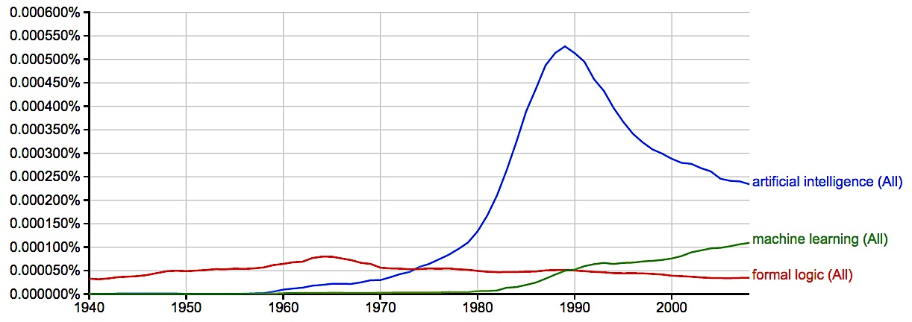
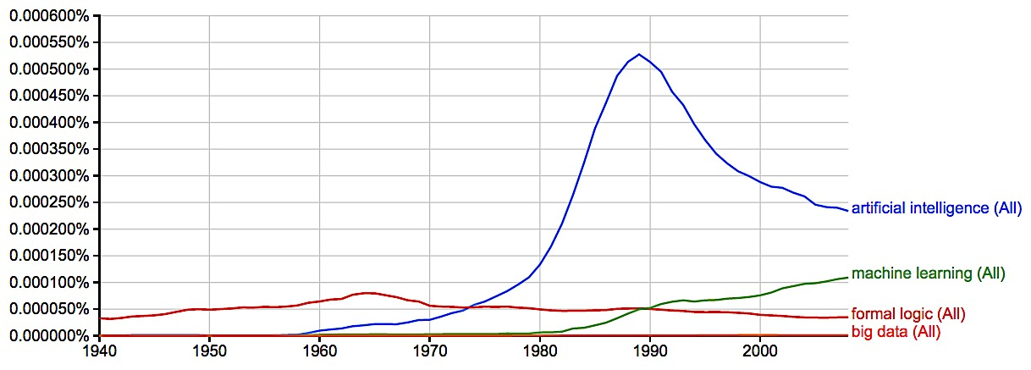
Summary of AI History
Knowledge Based
Systems
1970-1990
AI
Excitement!
1950-1970
Statistical Approaches
1990--
artificial intelligence
machine learning
formal logic
big data
2008
Google ngrams

Slide 26
Outline
What is AI?
Some AI history: AI winter and the resurgence!
AI Techniques:
Logic
Search & Planning
Probability & Statistics (Machine Learning)
AI Applications
Natural Language
Vision / Perception
Robotics
Much, much more

Slide 27
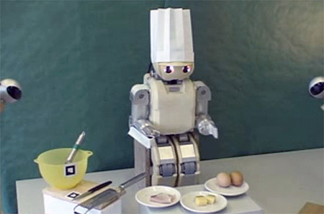
What intelligent things do people do?
Imagine cooking a meal with your roommates…
Planning
(Machine) Learning
Natural Language Processing
Motion and manipulation
Perception
Creativity
en.wikipedia.org/wiki/Artificial_intelligence

Slide 28

Techniques: Logic
A formal representation of our knowledge of the world
Use knowledge base and perception to infer new knowledge
Notes:
Examples:
supervised can learn to distinguish different classes of things (E.g., what part of speech are words in a sentence?), application to Kahn academy: predict if person will get next problem right
Unsupervised: learn representations (how do these objects differ from one another?)
Reinforcement learning: playing a game, learning to walk (http://www.youtube.com/watch?v=SJS22jQTdSU)

Slide 29
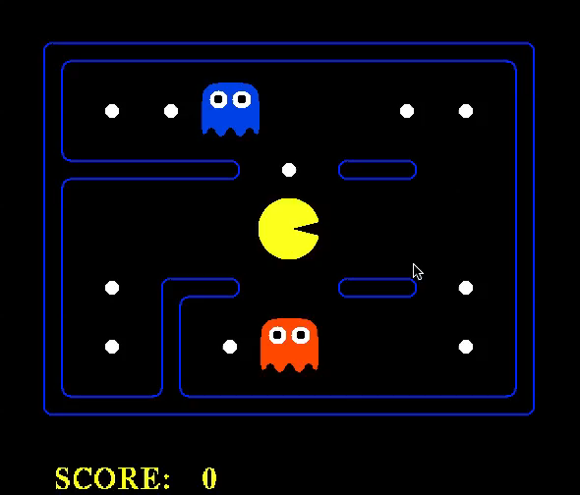
Techniques: Logic
Notes:
Examples:
supervised can learn to distinguish different classes of things (E.g., what part of speech are words in a sentence?), application to Kahn academy: predict if person will get next problem right
Unsupervised: learn representations (how do these objects differ from one another?)
Reinforcement learning: playing a game, learning to walk (http://www.youtube.com/watch?v=SJS22jQTdSU)

Slide 30

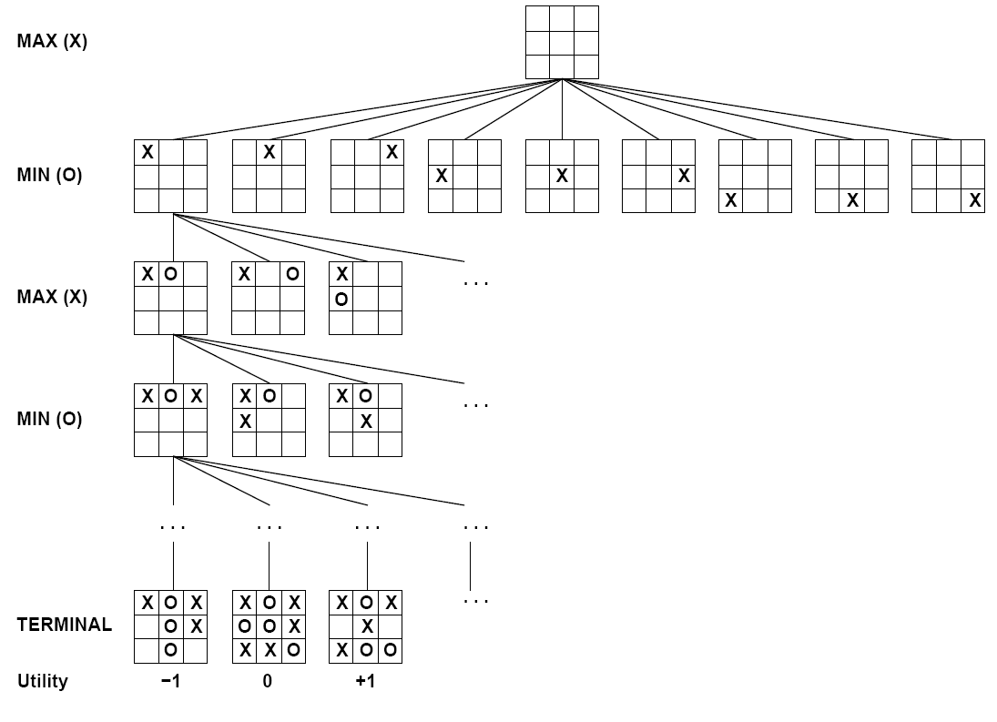

Techniques: Search & Planning
I take an action…then what?...then what?
Notes:
Examples:
supervised can learn to distinguish different classes of things (E.g., what part of speech are words in a sentence?), application to Kahn academy: predict if person will get next problem right
Unsupervised: learn representations (how do these objects differ from one another?)
Reinforcement learning: playing a game, learning to walk (http://www.youtube.com/watch?v=SJS22jQTdSU)

Slide 31
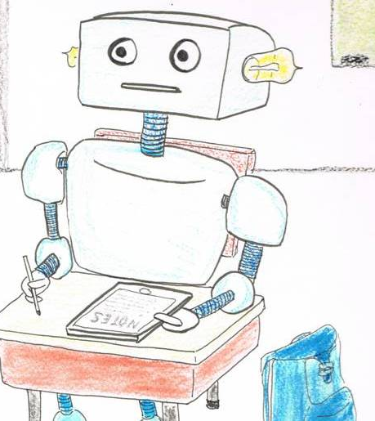
Techniques: Machine Learning
“A program learns if, after an experience, it performs better”
– Tom Mitchell, CMU
Machine learning enables a program to act without behavior being explicitly programmed.
Need to discover the right generalizations
en.wikipedia.org/wiki/Machine_learning
Notes:
Examples:
supervised can learn to distinguish different classes of things (E.g., what part of speech are words in a sentence?), application to Kahn academy: predict if person will get next problem right
Unsupervised: learn representations (how do these objects differ from one another?)
Reinforcement learning: playing a game, learning to walk (http://www.youtube.com/watch?v=SJS22jQTdSU)

Slide 32

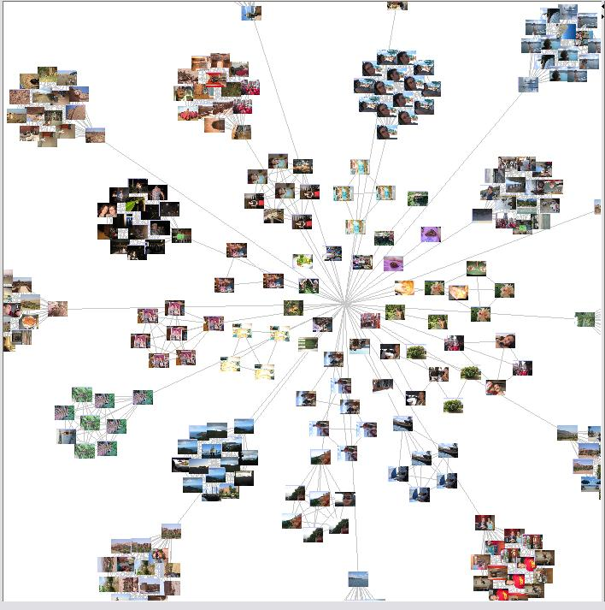
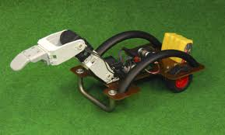
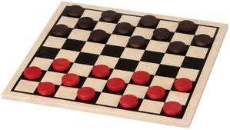
Techniques: Machine Learning
Algorithm Types
Supervised learning
Give a system input & output training data, and it produces a classifier
Unsupervised learning
Determine how data is organized or clustered
Reinforcement learning
No training data, real-time corrections adjust behavior
SPAM
SPAM
HAM
HAM
HAM
?
en.wikipedia.org/wiki/Machine_learning
Notes:
Examples:
supervised can learn to distinguish different classes of things (E.g., what part of speech are words in a sentence?), application to Kahn academy: predict if person will get next problem right
Unsupervised: learn representations (how do these objects differ from one another?)
Reinforcement learning: playing a game, learning to walk (http://www.youtube.com/watch?v=SJS22jQTdSU)
Emphasize that multiple algorithms can be applied – what you choose depends both on the setup of the task and your goals

Slide 33
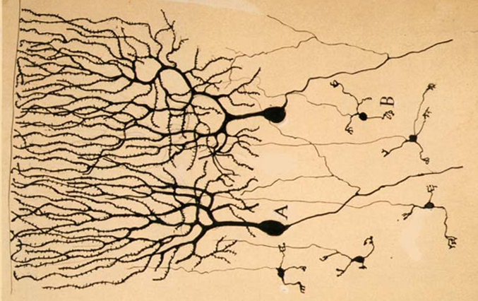
Example: Neural Network
Input Data
Output Signal
A
Σ
B
Σ
Σ
C
Σ
en.wikipedia.org/wiki/Neuron

Slide 34
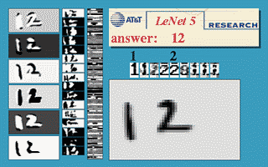

Example: Neural Network
Neural network trained to recognize handwritten digits
http://yann.lecun.com/exdb/lenet/a12.html
Notes:
http://yann.lecun.com/exdb/lenet/a12.html

Slide 35
Outline
What is AI?
Some AI history: AI winter and the resurgence!
AI Techniques:
Logic
Search & Planning
Probability & Statistics (Machine Learning)
AI Applications
Natural Language
Vision / Perception
Robotics
Much, much more

Slide 36
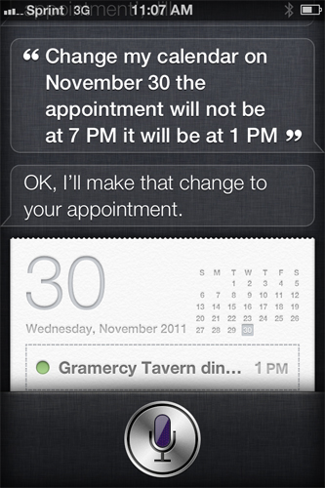
Application: Natural Language
Speech technologies (e.g. Siri)
Automatic speech recognition (ASR)
Text-to-speech synthesis (TTS)
Dialog systems
Language processing technologies
Question answering
Machine translation
Web search
Text classification, spam filter, etc…

Slide 37
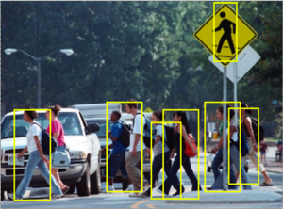
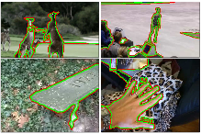
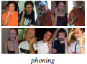
Application: Vision (Perception)
Tasks related to understanding images/camera input
Pedestrian detection
Action recognition
Figure/ground segmentation
(Some images from Berkeley vision group)

Slide 38
Application: Vision (Perception)
Video: Terminator
https://www.youtube.com/watch?v=9MeaaCwBW28

Slide 39
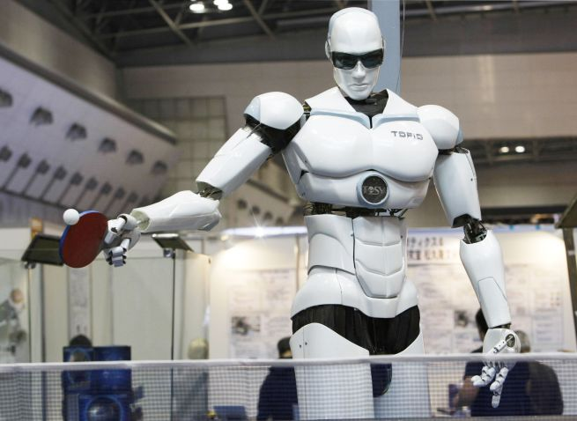
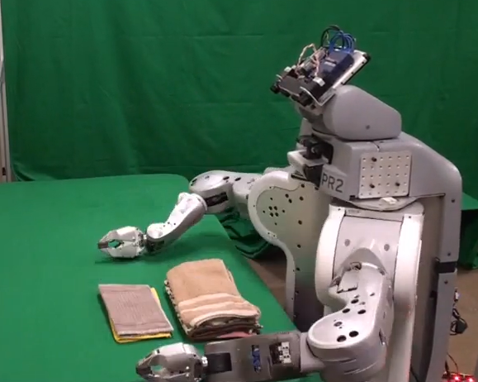
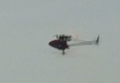
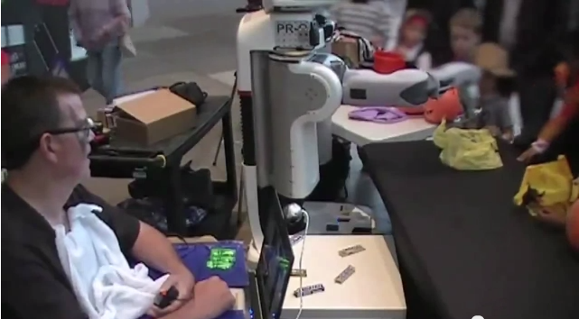
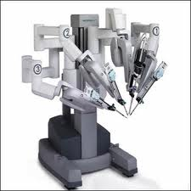
Application: Robotics
For many, the coolest and scariest part of AI
Combines fields of AI/CS
Speech recognition
Synthetic voice
Machine vision
Planning
HCI
TOPIO, the ping-pong playing robot
Surgical robots
Autonomous helicopter
UC Berkeley’s towel-folder
Assistive robots
en.wikipedia.org/wiki/Robotics
Notes:
http://www.youtube.com/watch?v=gy5g33S0Gzo – towel folding
http://www.youtube.com/watch?v=SqBw7XapJKk – bicycle robot

Slide 40
Application: Robotics
Video: Towel Folding
http://www.youtube.com/watch?v=gy5g33S0Gzo
Video: Bicycle Robot
http://www.youtube.com/watch?v=SqBw7XapJKk
Notes:
http://www.youtube.com/watch?v=gy5g33S0Gzo – towel folding
http://www.youtube.com/watch?v=SqBw7XapJKk – bicycle robot

Slide 41

Application: Much, Much More
Scheduling, e.g. airline routing, military
Route planning, e.g. Google maps
Medical diagnosis
Web search engines
Spam classifiers
Automated help desks
Fraud detection
Product recommendations
… Lots more!

Slide 42
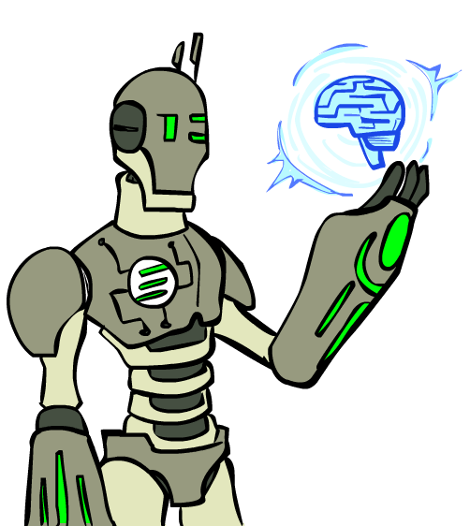
Summary
AI systems excel in things computers are good at
Big data (using web to parse language)
Constrained worlds (chess, math)
It’s getting better at…
Language understanding
Real-time robotics
Lots more applications that I didn’t have time to talk about!
CS188: Artificial Intelligence
One of the most popular courses on campus!
CogSci131: Computational Models of Cognition

Slide 43
That’s all folks
Thanks!
Feel free to send me questions:
Pat Virtue
virtue@eecs.berkeley.edu

